Slide 1
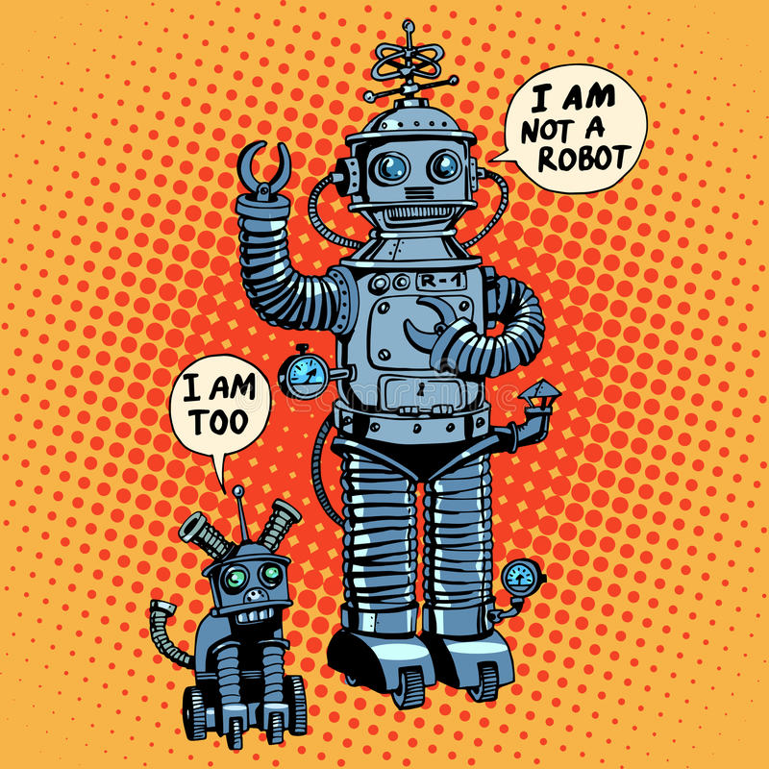
The patient, the physician and the health system
in the digital age
pierre.corvol@academie-sciences.fr
Ottawa, septembre 2019

Slide 2
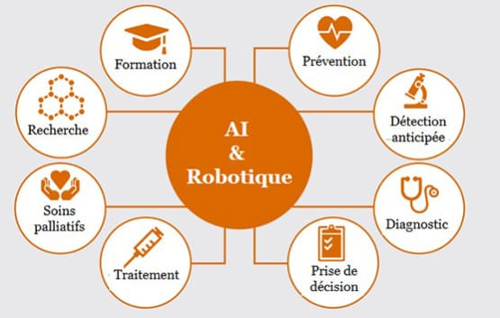
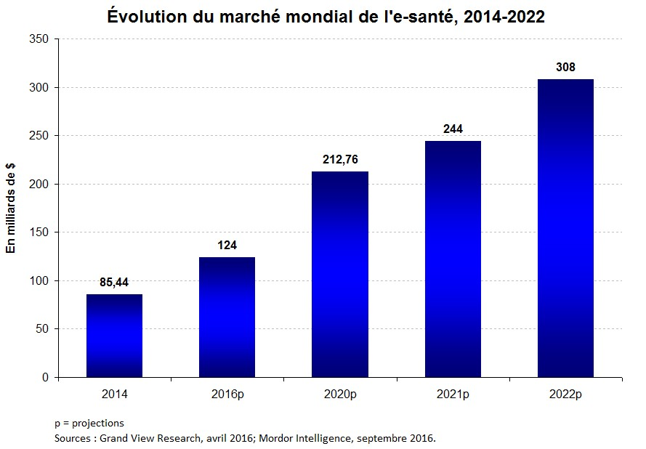
The patient, the physician and the health system
Digital revolution of the health system

Slide 3
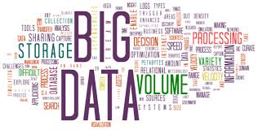
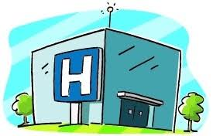
The patient, the physician and the health system
IA
Algorithmes

Slide 4
The patient in the digital age
Outclinic apppointments
Internet : 2nd source of health informations
Reliable sites : Ministry of Health, High Autority of Health,
Cochrane
IA
Algorithmes
Patient participation in the health system
Patient networks
French Federation of diabetics(1938)
Rare diseases PatientsLikeMe (2005)

Slide 5
The patient in the digital age
Connected health
Biometric, physical, biological parameters (blood sugar, creatinine, …)
Body weight, BP, ECG, physical activity, sleep, nutrition,…
Environmental factors
IA
Algorithmes
13 % of French people use a connected health object; 40% ready to use a smartphone
app in health; 78 % ready to share their health data
(Whist Inserm survey)

Slide 6
Connected health – Connected objects
More than 100,000 health applications (20,000 in French)
Blood pressure, blood glucose, insulin pump, oximetry, ECG, physical activity ...
Sleep: more than 500 applications
Self treatment
Health-care: connected objects
Scales, clothes, toothbrushes, bracelets,…
Differentiate:
1/ Well-being – self measurement (« Quantified-self ») (sport, food,..)
2/ Pathology (diagnosis, monitoring of biological parameters, treatment)
Challenges: Reliability? Absence of medical validation (> 50% no legal mention)
Medico-economic interest? Actual benefit ? Reimbursement ?
Treatment compliance (e-pill treatment), ...

Slide 7
The physician in the digital age
Electronic health record
Shared medical file (law of January 26, 2016)
Connection to patient health data
Tele-medicine since 2010 (expertise, assistance, monitoring,…)
Tele-advice, Tele-dialysis, …
IA
Algorithmes
70% of physicians consider it necessary to integrate digital in the organization
of care in the whole country
Help with diagnosis, therapy, prognosis, patient follow-up

Slide 8
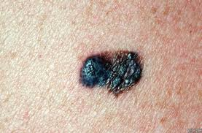
The dermatologist smartphone
Skin cancer:
Dermatological diagnosis
Deep learning: convolutional neural networks
Diagnosis of the most common malignancies
(carcinomas) and the most fearsome (melanomas)
130,000 images (2,000 cutaneous pathologies)
Confrontation with 21 dermatologists
Esteva et al, Nature 2017

Slide 9
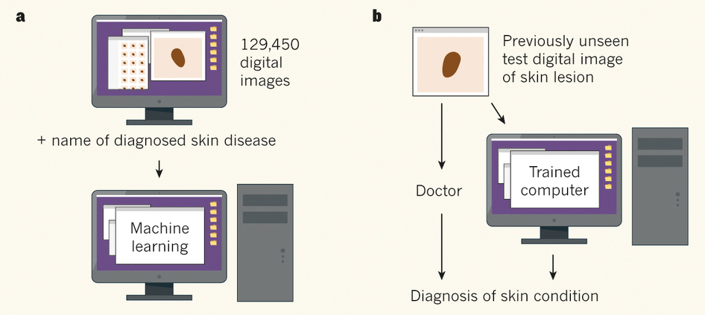
The dermatologist smartphone
Leachman S and Merlino G, Nature 2017

Slide 10
4 P Medicine in the digital age
Predictive, precision, participatory, preventive
Current applications :
Medical imaging
Ophtalmology (diabetic retinopathy,…)
Pathology
Pharmacoepidemiology
Telesurgery
Automated monitoring of treatment

Slide 11
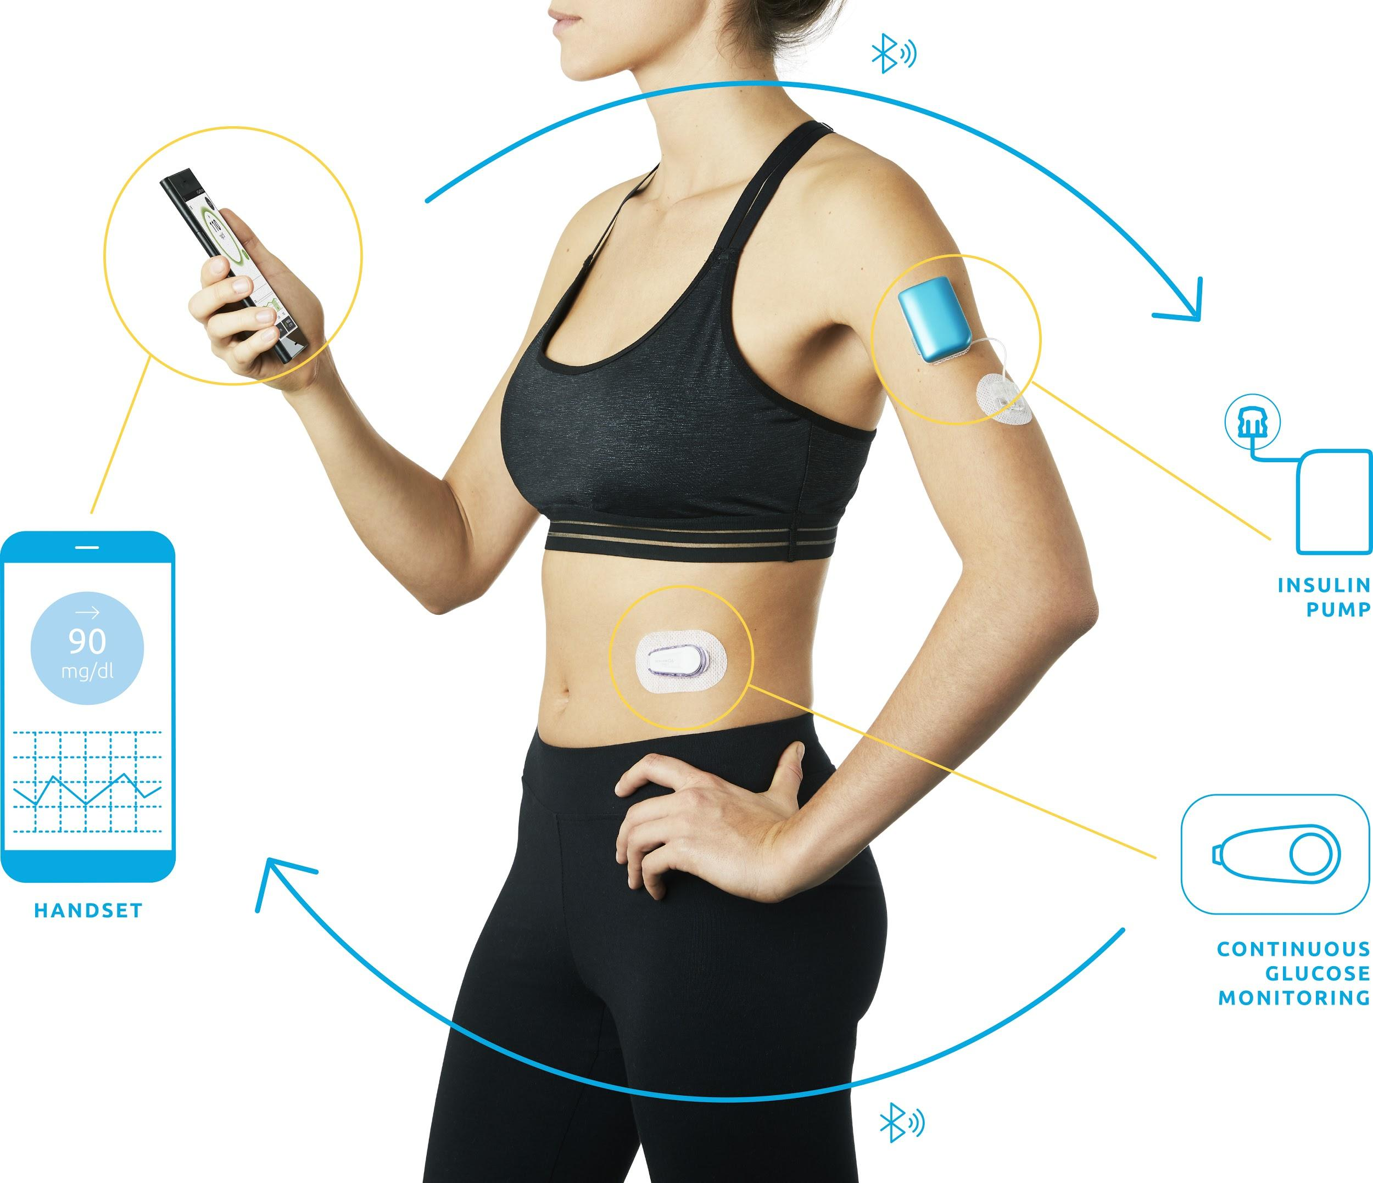
Personalized and autonomous diabetes type 1 management
250 000 patients in France
2 million in Europe, 1.5 million in the US
Need to inject the right dose of insulin 4-6 times/day
Machine learning
Automatic delivery of the correct dose of insulin de la dose
every 5 min
150 millions equations resolved per day,
per patient
Diabeloop

Slide 12
Personalized and autonomous diabetes type 1 management
Decision making algorithm in three steps
1
Hypo minimizer
Safety first
Machine learning
Physiological framework
2
Short term
Expert system
+
3
Machine learning
Long term
Notes:
Modules 1 & 2 run every 5 minutes. The Machine Learning’s reliability is evaluated continuously, and if its confidence level is low the decision is handed over to an expert system (which is not really machine learning, just a decision tree with multiple equations). Everyone knows the article on machine learning vision system from Google that could predict that a photo was a cat 99 times in a row, but the 100th time said it was a coliflower. In Diabeloop’s case as well, sometimes the Machine Learning doesn’t understand the situation. Which is why we have this continuous confidence methodology as well as a back-up algorithm.
Module 3, the long-term machine learning, is evaluating patterns in the lifestyle or physiology of the person (night vs day, week-end vs week, etc…) and integrates those patterns into the short-term algorithms.

Slide 13
The health system in the digital age
Electronic Health Record (EHR)
Structured and coded data (i2b2)
SNIRAM data + PMSI 1.2 billion sheets care, 500 million medical procedures, 11 million hospital stays
Data storage (biomedical data warehouses)
IA
Algorithmes

Slide 14
The health system in the digital age
Studies in health economics, extraction of original data
Improvement of the health care system
Medico-economic studies
Evaluation of diagnostic procedures, therapeutic innovation, ...
IA
Algorithmes

Slide 15
Big data, AI and socio-economic impact
Decision-making in public health
Inequality-reducing interventions
Performance/quality measurements and reward
Global evaluation of innovation in terms of behavorial changes and benefits for patients
500 000 sleep apneas in France
Controversy about reimbursemnt of sleep apnea treatment (PPC)
Reimbursement if treatment adherence
Legal controversy

Slide 16
Consultation, diagnosis, treatment, follow-up
Before e-Health
e-Health
Basic data, biometrics, age, sex
Profession, height, weight,..;
EHR
Digital imaging
Medical history,
physical examination
Genomic data, « omiques »
Data from connected objects
Biologic exam
Environmental data
(exposome)
Additional tests
Imaging
Diagnosis, treatment, prognosis
Expert system
Evidence-based medicine
Decision making
Help with diagnosis
Diagnosis of rare disease
Help with prognosis and treatment
Help with the decision

Slide 17
ARTEMIS, a computerized system for hypertension
(Département informatique médicale, UMRS Centre de recherche
des Cordeliers, Unité d’HTA)
1980 – Broussais hospital then HEGP
55 000 hypertensive patients
Computerized file 400 – 500 items
Basic biologic data
Treatment and follow-up of patients
Structured data
Textual analysis
Link with SNIIRAM and PMSI data
No integration of imaging data,
Nor genomic data
Several results:
Management tool
Expert system
Socio-cultural inequalities and high BP
First genetic studies of familial hypertension
« Profile » of the non-observant
Side effects of spironolactone
Data on morbidity and long-term mortality

Slide 18
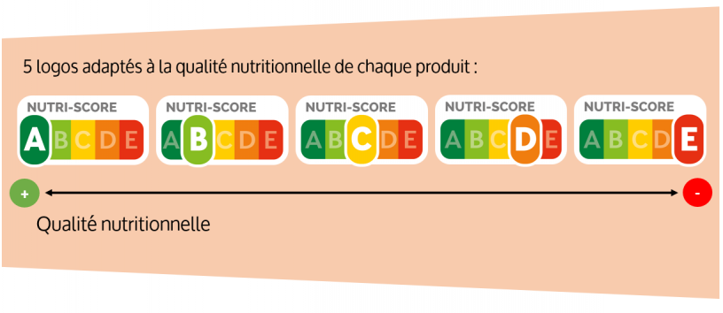
« Classical » epidemiology vs analysis of big data
« Classical » epidemiology
Hypothesis-based
Data extraction
No assumption a priori
Transversal and longitudinal studies
Cohorts (Framingham, Epipage,Constance)
Studies in real population
Environnemental factors
SNDS data base
Benefits and limitations
Reliability, robustness
Defined scope
Unexpected side effects
Pharmacoepidemiology
Medico-economic studies
Cohorte Nutrisanté

Slide 19
Present benefits of the use of big data
Generation of new knowledge
Improved public health surveillance and response to incidents
(salmonella outbreaks, influenza pandemics,…)
Cancer screening
Routine monitoring of chronic illness in specific populations
Pharmaco-epidemiology and drug safety
Early detection of adverse drug reactions (internet social networks)
Pragmatic trials in the « real world »
(Healthcare Systems Research Collaboratory – NIH)

Slide 20
Challenges
Evaluate the benefit for the patient, the doctor, the health system
Medico-economic assessment?
"Explainable" AI Systems
Medical responsibility
Fear about the absence of respect of personal data, about their surreptitious use
(GAFA, Insurance companies, hiring by companies...)
GAFAM's growing role in the health system
Completely rethink the training of doctors and health personnel
And the man in all that ?

Slide 21
Health in the digital age
Benefits :
Better disease management
Unexpected discoveries
Complex interactions (exposome)
Democratization of health
Opening up of health
Patient participation
Better expectancy and quality of life
Fears :
Breach of confidentiality
Break human link
Fake news
Suspicion,skepticism
Source of profits
Incentivesfor consumption
Energy cost

Slide 23
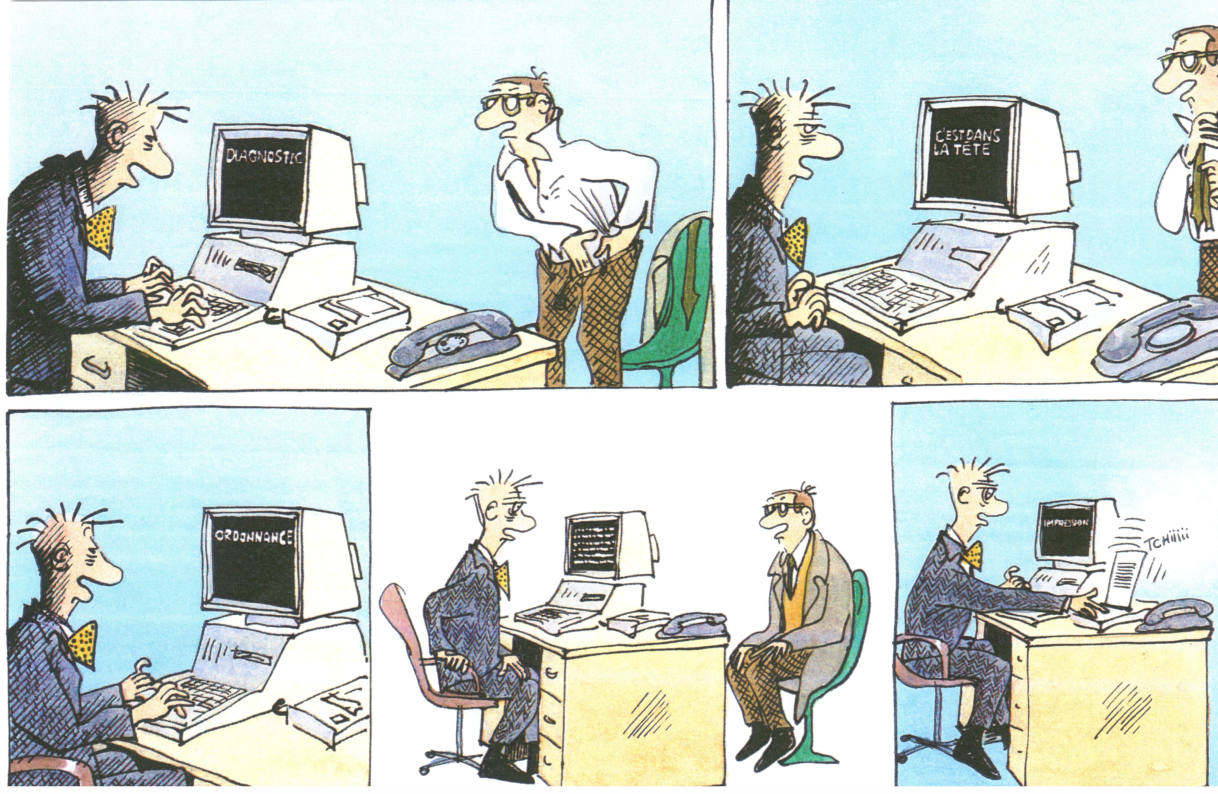
Claire Brétécher et le Dr. Ventouse (Bobologue)

Slide 24
